Slide 1
Distributed Rate Limiter

Slide 2
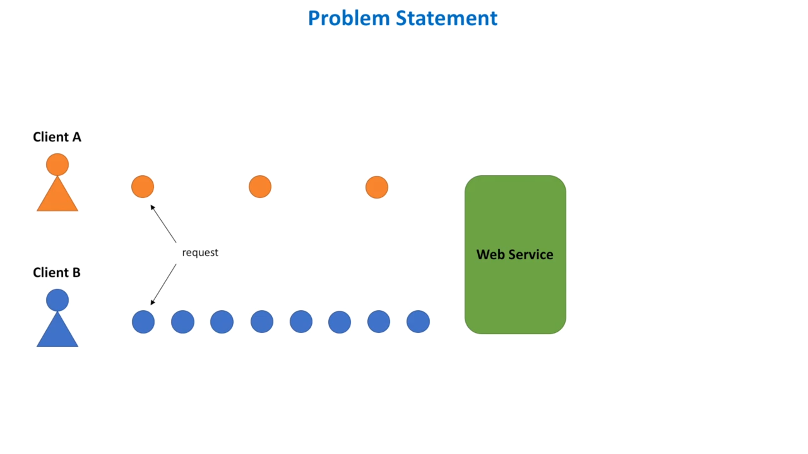
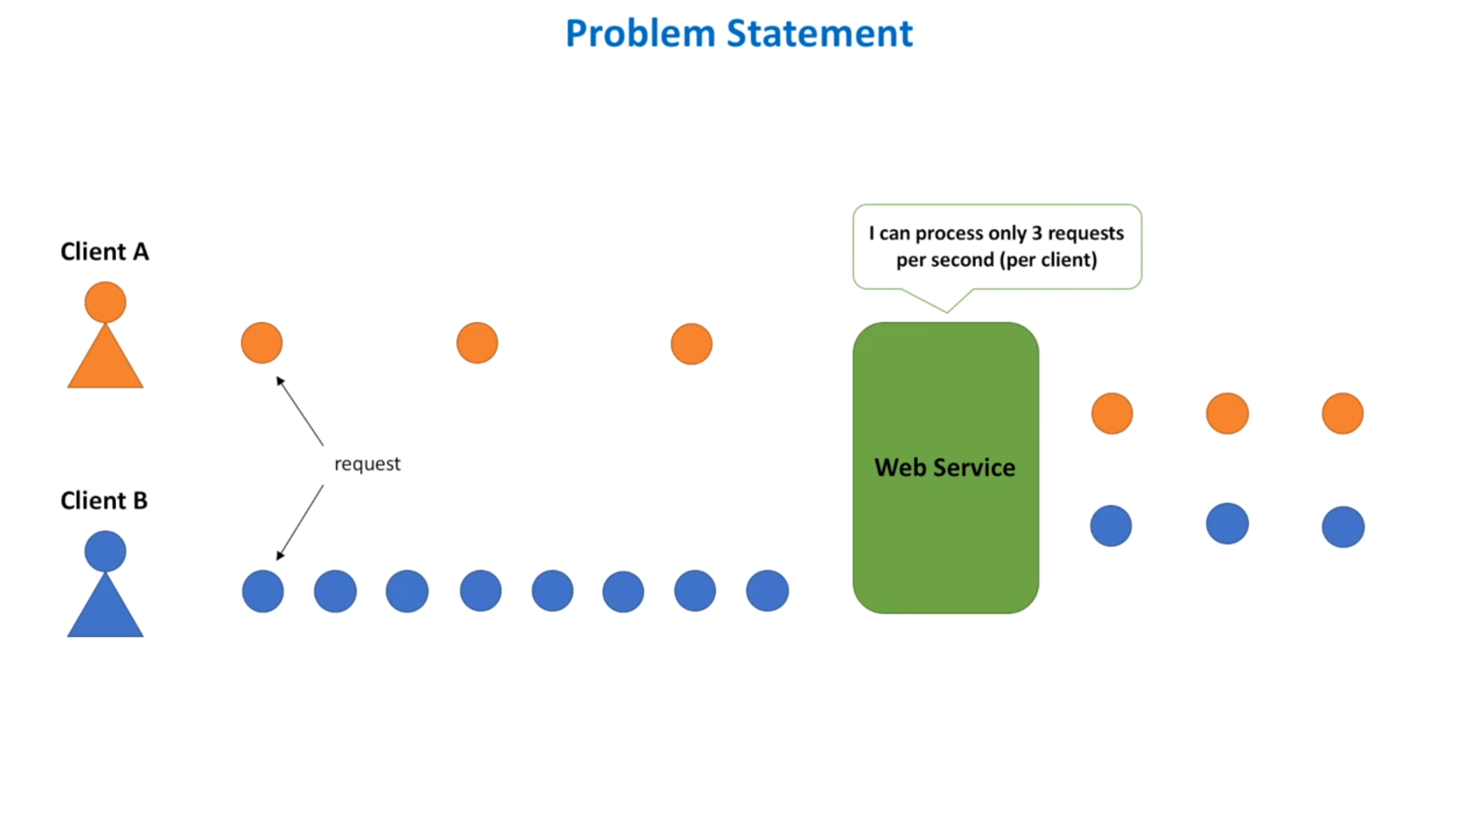

Slide 3
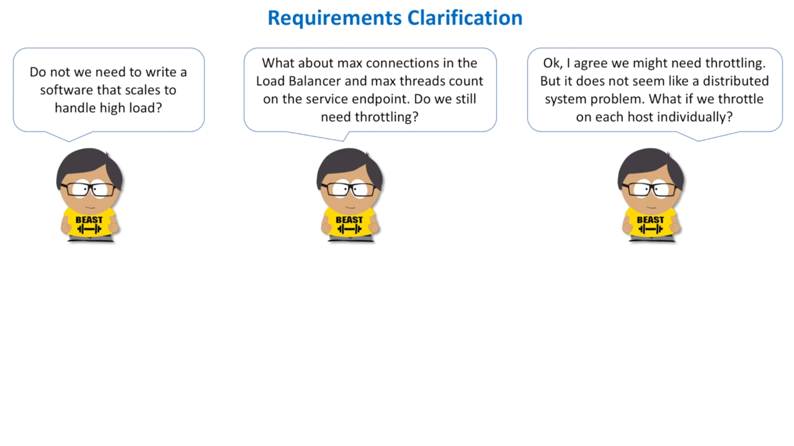
Auto scaling is an option but
scaling out and scaling in takes time. So by the time scaling process is complete, it may already be late.
We can introduce load balancer to balance the load by rejecting the requests or queuing them for future processing. But a Load Balancer doesnot have the knowledge of the cost of a particular operation.

Slide 4
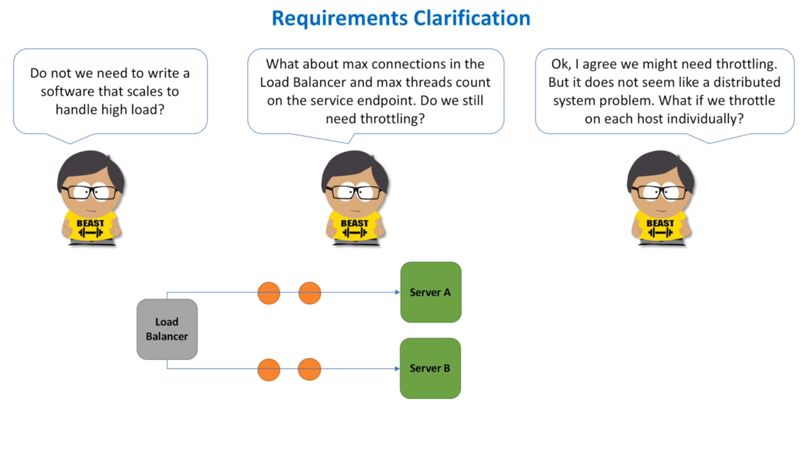

Slide 5
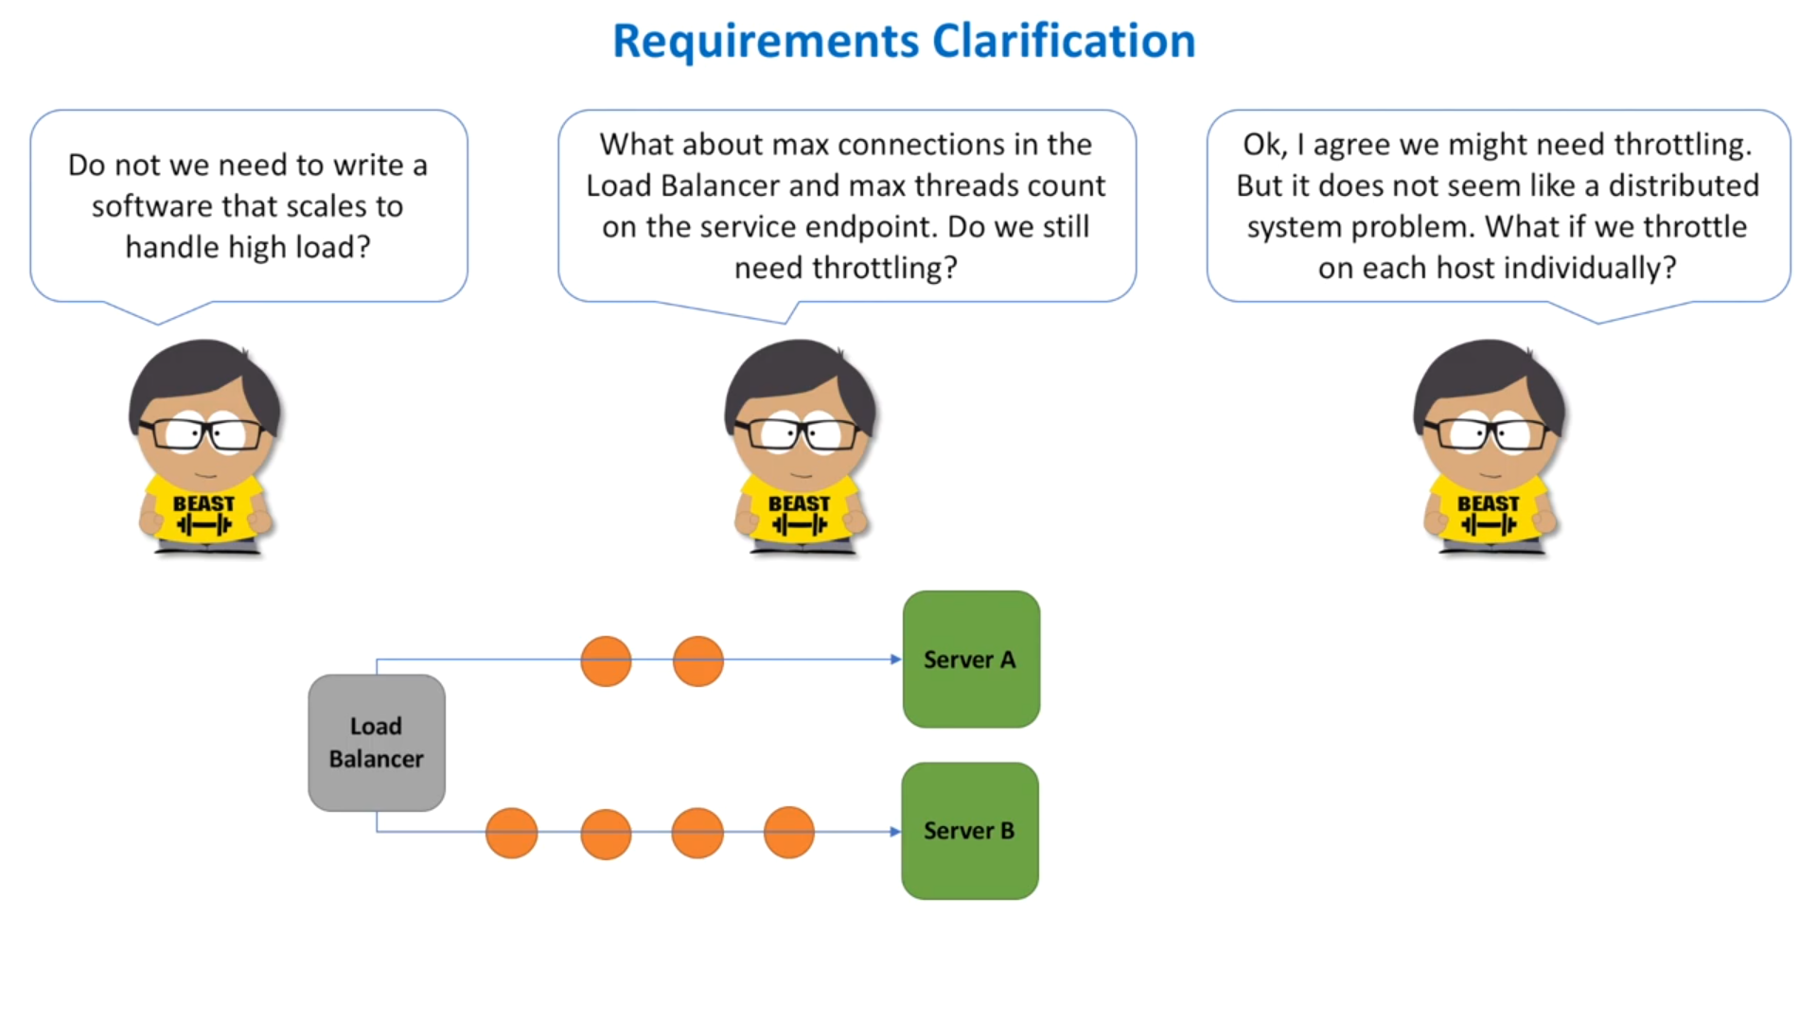
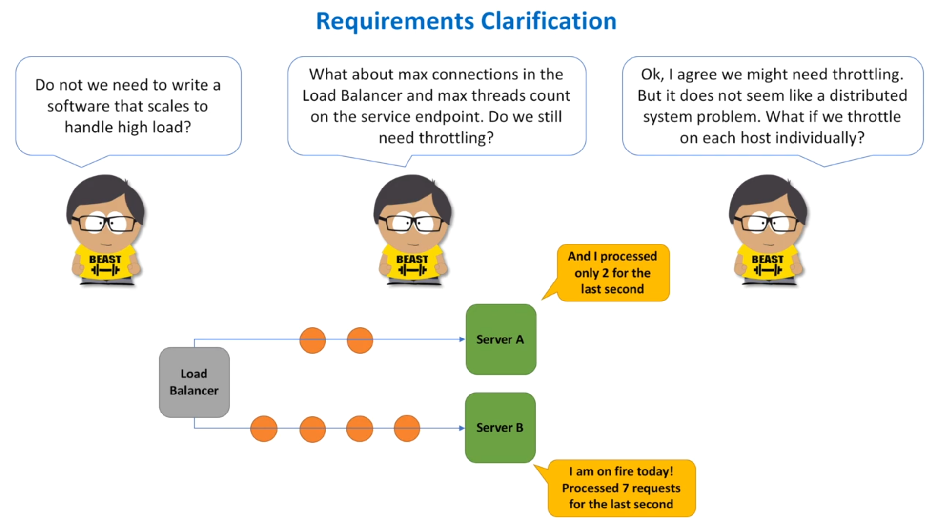
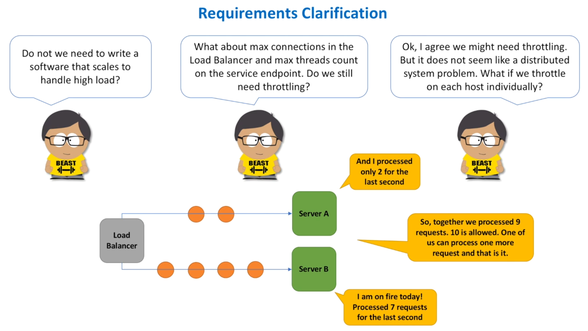

Slide 6
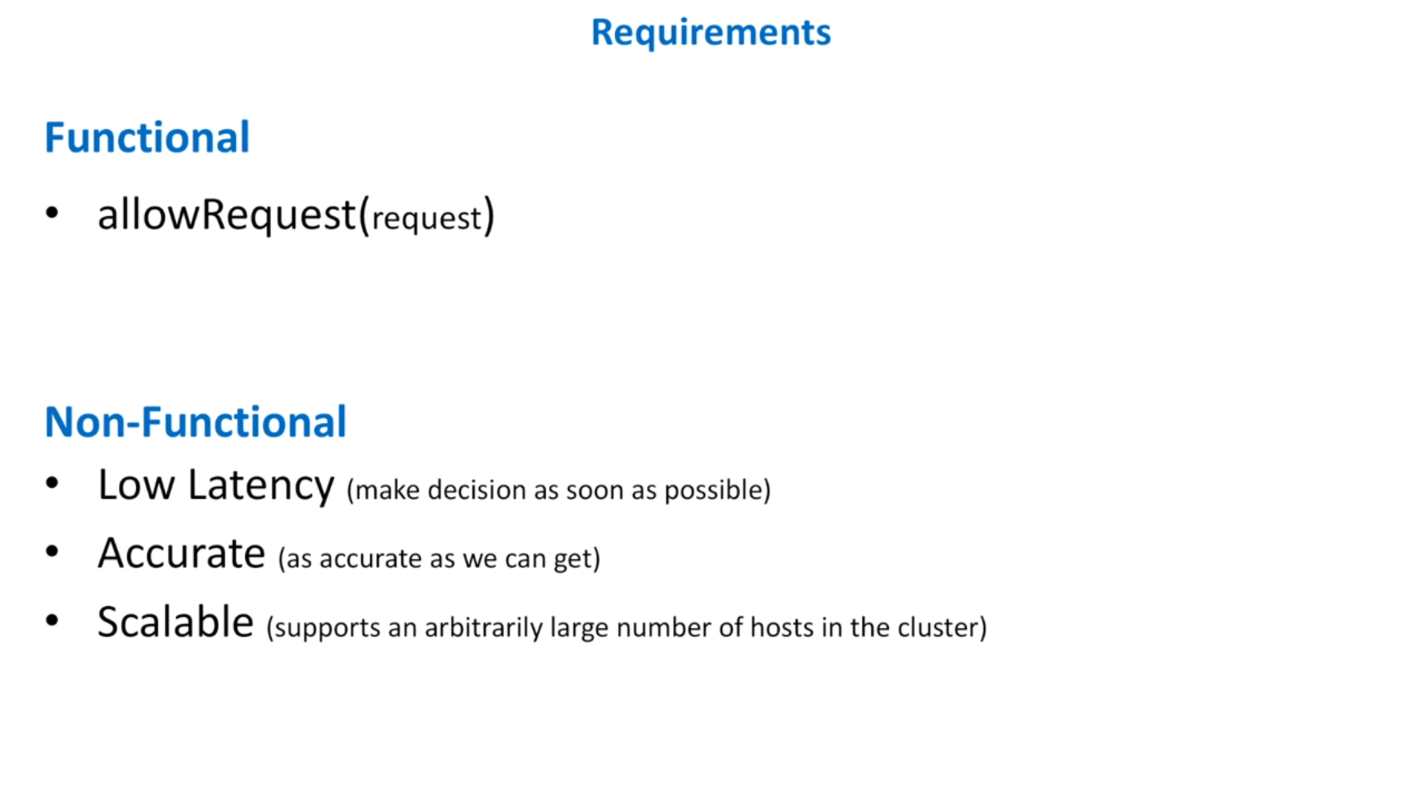

Slide 7
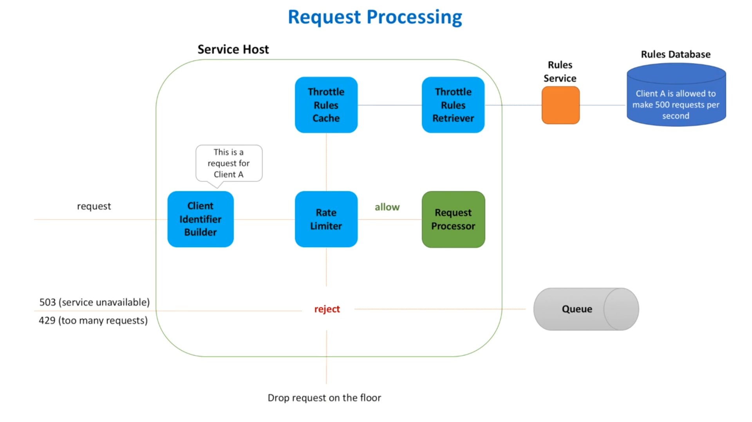

Slide 8
Throttle Rules Retriever - Each rule specifies a number of requests allowed for a particular client per second. These rules are defined by service owners and are stored in a database. It is a background process that polls rules database periodically for any change in rules.
Rules Database - Stores all the rules per client.
Rules Service - Web service that manages all the operations with rules. CRUD service.
Throttle Rules Cache - The rules retriever caches all the rules in a cache.
Client Identifier Builder - This service creates an unique identifier called key for each client using ip or login for a registered client.
Rate Limiter - The key created by Client Identifier Builder is passed to rate limiter component. It checks the rules cache against this key to get the rules and decides if the number of requests made by the client in the last second is below the limit specified by the rule.
If threshold is not exceeded, the request is passed further to request processor else it is rejected.
If rejected, we can either drop the request, or return specific status code or enqueue it for later processing.

